Slide 1

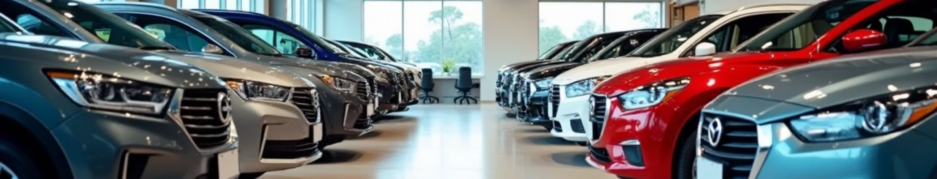
Used Cars Price Prediction Using Machine Learning
Kaveri Jarhad

Slide 2

CONTENTS
1. Introduction: Problem Statement & Objective
2. Dataset Description
3. Methodology
4. Results & Performance Analysis
5. Conclusion & Future Work
6. Thank You!

Slide 3


Introduction: Problem Statement & Objective
1
Problem Statement
2
Objective
• Predicting the selling price of a used car is a complex task influenced by many factors. A good prediction model can assist both buyers and sellers in making informed decisions.
• To build and evaluate a machine learning model that accurately predicts the selling price of used cars based on historical data.

Slide 4


Key Features of Dataset
Car_Name
Year
The name of the car model.
The year the car was purchased.
Selling_Price
Present_Price
The price at which the car was sold (Target Variable).
The current showroom price of the car.
Kms_Driven
Fuel_Type
Total kilometers the car has driven.
Type of fuel the car uses (e.g., Petrol, Diesel, CNG).
Seller_Type
Transmission
The type of seller (e.g., Dealer, Individual).
Type of transmission (e.g., Manual, Automatic).
Owner
Number of previous owners.

Slide 5


Methodology
Data Preprocessing
Model Selection
• The dataset contained categorical features (Fuel_Type, Seller_Type, Transmission).
• Linear Regression: A foundational statistical model that models the relationship between a dependent variable and one or more independent variables by fitting a linear equation to the observed data.
• These categorical features were converted into a numerical format using a suitable encoding technique (e.g., One-Hot Encoding).
• Lasso Regression: A type of linear regression that includes a regularization term (L1 penalty) to prevent overfitting and select the most important features.

Slide 6
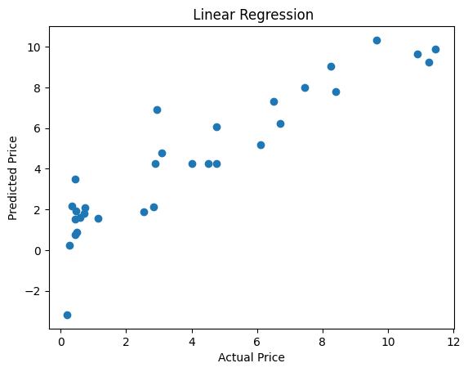
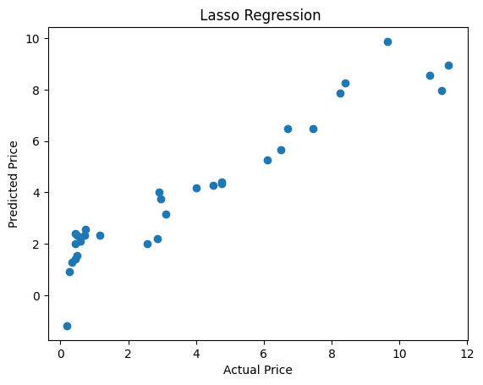
Results & Performance Analysis
Model Performance
• Linear Regression: Achieved an accuracy of 83%.
• Lasso Regression: Achieved an accuracy of 84%.
Comparison
• Both models performed well, but Lasso Regression demonstrated a slightly higher accuracy, suggesting it was more effective at handling the dataset, likely due to its regularization properties.

Slide 7


Conclusion & Future Work
Conclusion
Future Work
• The project successfully demonstrated that machine learning models, particularly Lasso Regression, can be used to predict used car prices with a high degree of accuracy. The chosen methodology of encoding categorical data and applying regression models proved effective.
• Explore other advanced regression models like Ridge Regression or Random Forest Regressor.
• Gather a larger dataset to improve model generalization.
• Perform more in-depth feature engineering to create new, predictive variables.

Slide 8

Thank You

